Slide 1
Mockito & PowerMockito
Thanh Pham
pthethanh@tma.com.vn

Slide 2
Table of contents
Overview
Mockito
  Stubbing
  Argument matcher
  Verification
  Mock static
PowerMockito
  Mock Static
  Mock Final
  Mock Constructor
  Mock Partial
  Bypass Encapsulation
Notes
Q & A

Slide 3

Overview
Notes:
Divider Section Break Pages
Title block set 28/32pt Trebuchet white, flush left with text box positioned at, Horizontal 1.87” and Vertical 2.87”
This slide is to be used to create Section Divider slides
Please copy, paste and modify this slide to reflect your specific needs. It is not generated from a Master slide template

Slide 4
What is Mock?
  Mock are object that simulates the behavior of a real object.
  Or
  Substitutes of real objects for purposes of testing

Slide 5
Why Mock?
  Help design solution
  Avoid high coupling
  Promote high cohesion
  Easy to use
  Promote align development
  Improve performance of unit test
  ….

Slide 6
Where can I use Mock?
  Database
  Services
  Network
  Classes
You can mock what you want… ☺

Slide 7
Mockito
Notes:
Divider Section Break Pages
Title block set 28/32pt Trebuchet white, flush left with text box positioned at, Horizontal 1.87” and Vertical 2.87”
This slide is to be used to create Section Divider slides
Please copy, paste and modify this slide to reflect your specific needs. It is not generated from a Master slide template

Slide 8
Overview of Mockito
Mockito is a mocking framework that tastes really good. It lets you write beautiful tests with clean & simple API.
Some features:
  Mocks concrete classes as well as interfaces
  Little annotation syntax sugar - @Mock
  Verification errors are clean.
  Allows flexible verification in order.
  Supports exact-number-of-times and at-least-once verification
  Flexible verification or stubbing using argument matchers.
  Allows creating custom argument matchers or using existing hamcrest matchers
  …

Slide 9
How does it work?
Mockito uses CGLib and ASM to build generated classes at runtime (like Spring and Hibernate, use these tools to build runtime dynamic types for proxying)
Normal class:
  Mockito is building a new generated class that extends the test class, but has a "mock" implementation that can be configured by you.
Interface:
  Mockito build mocks of interfaces, by creating implementation for the interface protocol in the new mock class.
For more info about CGLib and ASM see below links:
http://cglib.sourceforge.net/
http://forge.ow2.org/projects/asm
Ex: LinkedList mockedList = mock(LinkedList.class);

Slide 10
1
Mockito: Stubbing
Notes:
Divider Section Break Pages
Title block set 28/32pt Trebuchet white, flush left with text box positioned at, Horizontal 1.87” and Vertical 2.87”
This slide is to be used to create Section Divider slides
Please copy, paste and modify this slide to reflect your specific needs. It is not generated from a Master slide template

Slide 11
Stubbing: Syntax
Syntax:
when(mockedObject.methodToMock).then…
when(mockedObject.methodToMock).thenReturn
when(mockedObject.methodToMock).thenThrow
when(mockedObject.methodToMock).thenAnswer
when(mockedObject.methodToMock).thenCallRealMethod
…
do…(…).when(mockedObject).methodToMock
doReturn(answer).when(mockedObject).methodToMock
doThrow(throwable).when(mockedObject).methodToMock
doNothing().when(mockedObject).methodToMock
doAnswer(answer).when(mockedObject).methodToMock
….

Slide 12
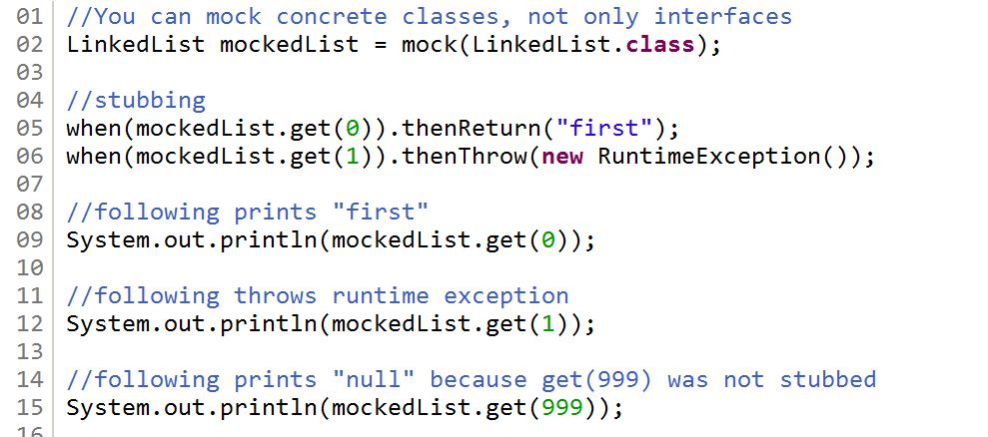
Stubbing: Examples

Slide 13
Stubbing consecutive calls
Sometimes we need to stub with different return value/exception for the same method call.
Syntax:
  when(mockedObject.methodToMocked).then…().then…()….
  when(mockedObject.methodToMocked).then…(<value1>, <value2>,…)

Slide 14
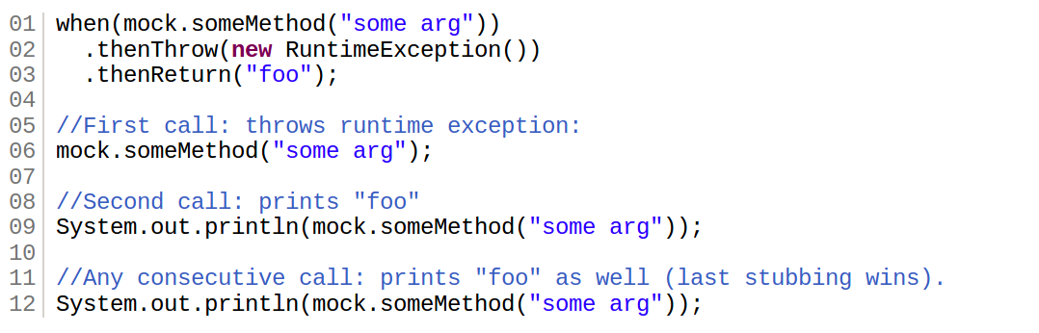
Stubbing consecutive calls: Examples
Short version:

Slide 15
Stubbing: notes
Default return value:
  Mock returns null, an empty collection or appropriate primitive/primitive wrapper value (e.g: 0, false, ... for int/Integer, boolean/Boolean, ...).
Stubbing can be overridden.
Once stubbed, the method will always return stubbed value.
Last stubbing is more important.
Plz consider to use doThrow/doReturn… when:
  Stubbing void
  Stubbing a method more than once
  Stubbing a method on a spy object.

Slide 16
2
Mockito: Argument Matchers
Notes:
Divider Section Break Pages
Title block set 28/32pt Trebuchet white, flush left with text box positioned at, Horizontal 1.87” and Vertical 2.87”
This slide is to be used to create Section Divider slides
Please copy, paste and modify this slide to reflect your specific needs. It is not generated from a Master slide template

Slide 17
Argument matchers
Mockito supports 2 types of matchers:
Built-in matchers:
  anyString(), anyInt(), isA(<Class>), eq(<value>), startWith(<value>), endWIth(<value>)…
  matches(<regex>)
Custom matchers
  Define:
    ArgumentMatcher<<Class>> customMatcher = ArgumentMatcher<<Class>> {
    public boolean matches(Object argument) {
      // Check something here on argument to return desired value
    return <booleanValue>;
    }
    }
  Use:
    Matchers.argThat(org.hamcrest.Matcher)

Slide 18
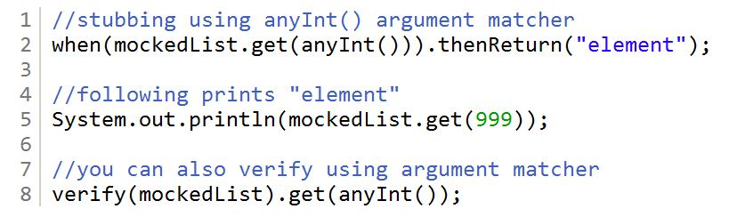
Argument Matchers: Examples

Slide 19
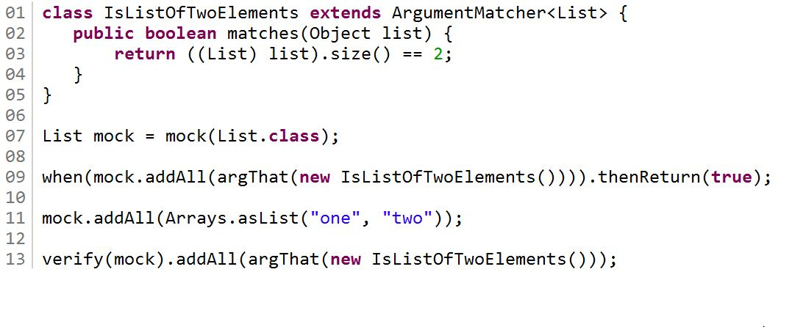
Argument Matchers: Examples

Slide 20
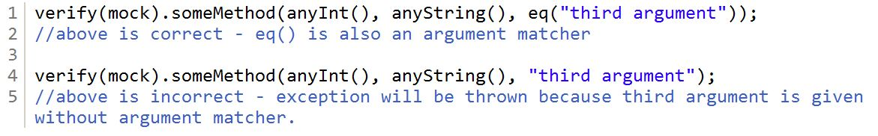
Argument Matchers: notes
If you are using argument matchers, all arguments have to be provided by matchers.

Slide 21
3
Mockito: Verification
Notes:
Divider Section Break Pages
Title block set 28/32pt Trebuchet white, flush left with text box positioned at, Horizontal 1.87” and Vertical 2.87”
This slide is to be used to create Section Divider slides
Please copy, paste and modify this slide to reflect your specific needs. It is not generated from a Master slide template

Slide 22
Verify mock interaction
Once created, mock will remember all interactions. Then you can selectively verify whatever interaction you are interested in.
Syntax:
  verify(mockedObject).mockedMethod
  verify(mockedObject, times(<NoTimes>).mockedMethod
  verify(mockedObject, atLeastOnce()).mockedMethod
  verify(mockedObject, atLeast(<NoTimes>).mockedMethod
  verify(mockedObject, atMost(<NoTimes>).mockedMethod
  verify(mockedObject, never()).mockedMethod
  verifyZeroInteractions(mockedObject…)
  verifyNoMoreInteractions(mockedObject)

Slide 23
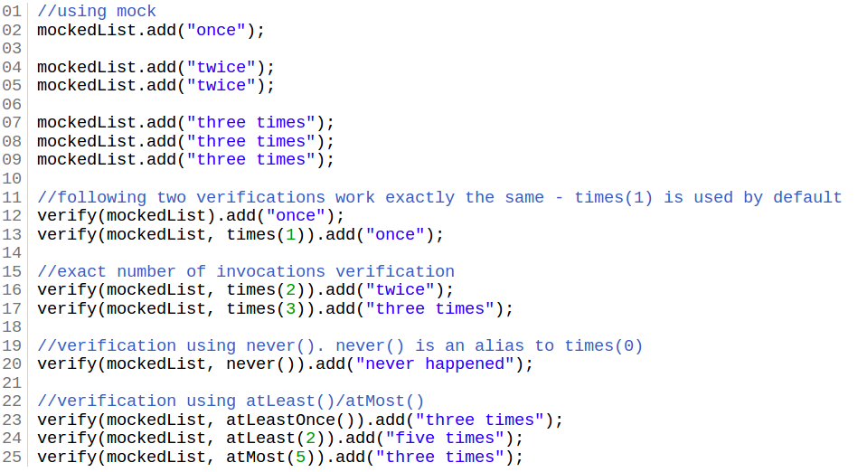
Verification: Examples

Slide 24
4
Mockito: Mock Static
Notes:
Divider Section Break Pages
Title block set 28/32pt Trebuchet white, flush left with text box positioned at, Horizontal 1.87” and Vertical 2.87”
This slide is to be used to create Section Divider slides
Please copy, paste and modify this slide to reflect your specific needs. It is not generated from a Master slide template

Slide 25
Mock Static: Preparation
  ClassNeedToBeTested {
    methodNeedToBeTested() {
      //Do something here
      StaticClass.staticMethod ();
      //Do something here
    }
  }
  We need to do a small refactor on our code above:
  ClassNeedToBeTested {
    methodNeedToBeTested() {
      //Do something here
      protectedMethod();
      //Do something here
    }
    protectedMethod() {
      StaticClass.staticMethod();
    }
  }

Slide 26
Mock Static: Perform mocking
  TestClass extends TestCase {
    StaticClass mockedStatic = mock(StaticClass.class);
    ClassNeedToBeTested classToBeTested = new ClassNeedToBeTested () {
      //Override the protected to return our mock
      protectedMethod() {
      return mockedStatic;
      }
    }
  }

Slide 27
PowerMockito
Notes:
Divider Section Break Pages
Title block set 28/32pt Trebuchet white, flush left with text box positioned at, Horizontal 1.87” and Vertical 2.87”
This slide is to be used to create Section Divider slides
Please copy, paste and modify this slide to reflect your specific needs. It is not generated from a Master slide template

Slide 28
Overview
  PowerMock: is a framework that extend other mock libraries such as EasyMock with more powerful capabilities
  Supports:
    Mock static method
    Mock final class/method
    Mock private method/Partial mock
    Mock constructor method
    Suppress constructor/methods
    Remove static initializer
    Bypass encapsulation
  Mockito + PowerMock = PowerMockito

Slide 29
How does it work?
Uses a custom classloader
Bytecode manipulation

Slide 30
1
PowerMockito: Mock Static
Notes:
Divider Section Break Pages
Title block set 28/32pt Trebuchet white, flush left with text box positioned at, Horizontal 1.87” and Vertical 2.87”
This slide is to be used to create Section Divider slides
Please copy, paste and modify this slide to reflect your specific needs. It is not generated from a Master slide template

Slide 31
Mock Static
Use:
@RunWith(PowerMockRunner.class)
@PrepareForTest(ClassThatContainsStaticMethod.class) PowerMock.mockStatic(ClassThatContainsStaticMethod.class)
Multiples class:
@PrepareForTest({ClassThatContainsStaticMethod.class, class2, class3…})
More details…
Note: use below syntax when you want to mock System classes (System, Runtime…)
@PrepareForTest(SystemClassUser.class)

Slide 32
2
PowerMockito: Mock Final
Notes:
Divider Section Break Pages
Title block set 28/32pt Trebuchet white, flush left with text box positioned at, Horizontal 1.87” and Vertical 2.87”
This slide is to be used to create Section Divider slides
Please copy, paste and modify this slide to reflect your specific needs. It is not generated from a Master slide template

Slide 33
Mock Final
Use:
@RunWith(PowerMockRunner.class)
@PrepareForTest(ClassWithFinal.class)
PowerMockito.mock(ClassWithFinal.class)
More details…
When:
Use final mocking incase you want to mock final class or final method

Slide 34
3
PowerMockito: Mock Partial
Notes:
Divider Section Break Pages
Title block set 28/32pt Trebuchet white, flush left with text box positioned at, Horizontal 1.87” and Vertical 2.87”
This slide is to be used to create Section Divider slides
Please copy, paste and modify this slide to reflect your specific needs. It is not generated from a Master slide template

Slide 35
Mock Partial
Use:
@RunWith(PowerMockRunner.class)
@PrepareForTest(ClassWithPrivateMethod.class)
PowerMockito.spy(ClassWithPrivateMethod.class)
PowerMockito.do…(ClassWithPrivateMethod.class, <privateMethod>,…)
More details…
When:
Use partial mocking incase you want to mock the current test class which extend from a tested class.
You can use this way to mock private/protected…methods

Slide 36
4
PowerMockito: Mock Constructor
Notes:
Divider Section Break Pages
Title block set 28/32pt Trebuchet white, flush left with text box positioned at, Horizontal 1.87” and Vertical 2.87”
This slide is to be used to create Section Divider slides
Please copy, paste and modify this slide to reflect your specific needs. It is not generated from a Master slide template

Slide 37
Mock Constructor
Use:
@RunWith(PowerMockRunner.class) @PrepareForTest(ClassThatCreatesTheNewInstance.class)
Mockito.mock(NewInstanceClass.class) ->mockObject
PowerMockito.whenNew(NewInstanceClass.class)…thenReturn(mockObject)
More details…

Slide 38
Suppress constructors
Use:
@RunWith(PowerMockRunner.class)
@PrepareForTest(ChildClass.class)
suppress(constructor(ParentClass.class))
When:
Use this when you want to suppress the parent constructor from derive classes

Slide 39
4
PowerMockito: Bypass Encapsulation
Notes:
Divider Section Break Pages
Title block set 28/32pt Trebuchet white, flush left with text box positioned at, Horizontal 1.87” and Vertical 2.87”
This slide is to be used to create Section Divider slides
Please copy, paste and modify this slide to reflect your specific needs. It is not generated from a Master slide template

Slide 40
Bybass encapsulation
Use:
Whitebox.setInternalState(..)
Whitebox.getInternalState(..)
Whitebox.invokeMethod(..)
Whitebox.invokeConstructor(..)
More details…

Slide 41
Notes
Notes:
Divider Section Break Pages
Title block set 28/32pt Trebuchet white, flush left with text box positioned at, Horizontal 1.87” and Vertical 2.87”
This slide is to be used to create Section Divider slides
Please copy, paste and modify this slide to reflect your specific needs. It is not generated from a Master slide template

Slide 42
Notes
  Just remember that stubbing goes before execution, verifications of interactions go afterwards.
  Don’t mock completely the class that you are trying to test
  Please makes me small as possible
  Check JUnit version before run test case.

Slide 43
Q&A
Notes:
Divider Section Break Pages
Title block set 28/32pt Trebuchet white, flush left with text box positioned at, Horizontal 1.87” and Vertical 2.87”
This slide is to be used to create Section Divider slides
Please copy, paste and modify this slide to reflect your specific needs. It is not generated from a Master slide template

